Slide 1
Email via Spring
Soham Sengupta

Slide 2
We will learn
How to send EMAILs from your Spring Application
GMAIL
OUTLOOK
Handling Text and Rich Texts
Create a RESTful web service that sends email
Loosely coupled systems
Tightening seat belts- We’d be flying to the world of Micro-services in a few days

Slide 3
Overview- Java Mail
Java Mail API helps you send emails programmatically
A rich set of APIs
Handles
Text messages
Rich Text messages (E.g. HTML body)
Multipart (e.g. Attachments)
Support for handling FOLDERs (E.g. INBOX etc.)
Supports SMTP, POP, IMAP [Don’t worry if you are not familiar with these]
Security of Mails – support for TLS.
Can be integrated with Gmail, Outlook – any Mail server .

Slide 4
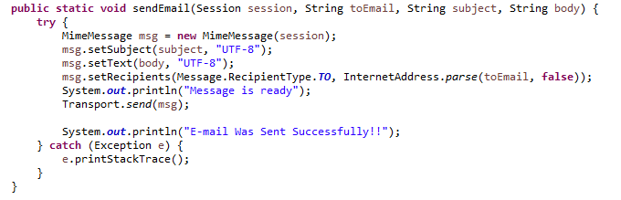

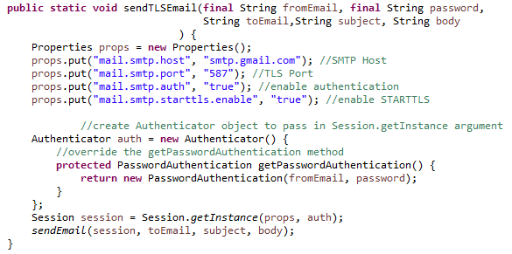
Code snippets

Slide 5
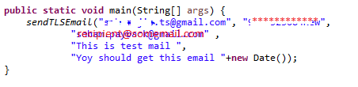
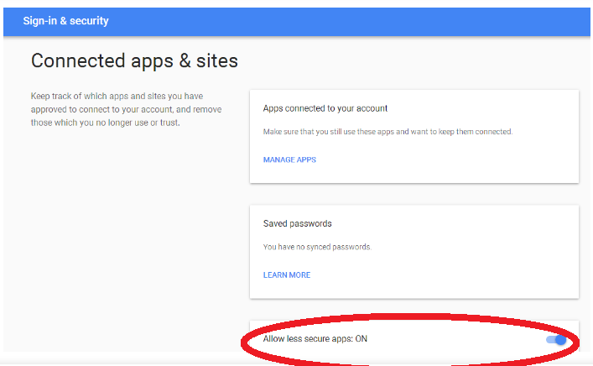
Let’s Test it ourselves
Use your Gmail Address and Password .
Use the method call like this
DID NOT WORK ?
Make sure that your Gmail Account accessible to Third party apps.

Slide 6
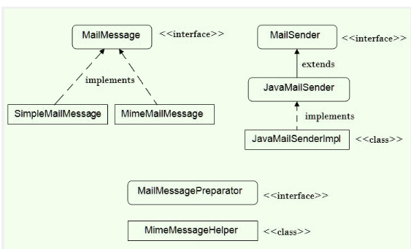
Spring Email – Major Neighbours

Slide 7
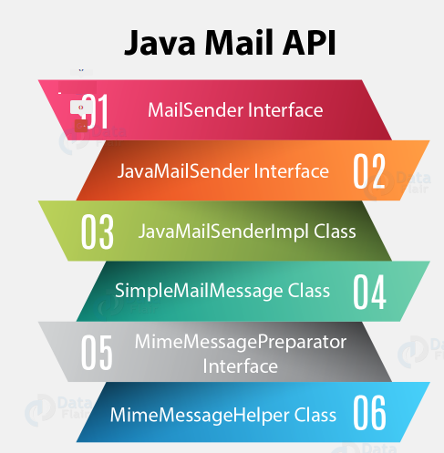
Spring Email
Basically based on Java Mail API only
Provides additional wrappers to avoid
boilerplate codes
MailSender -Interface
root of everything
Provides simple email functionalities
JavaMailSender - Interface
supports MIME messages
Is used with MimeMessageHelper

Slide 8
Spring Email
Basically based on Java Mail API only
Provides additional wrappers to avoid
boilerplate codes
JavaMailSenderImpl - Class
Implements JavaMailSender
supports JavaMail Mime Messages Spring Simple
Mail Messages
4. SimpleMailMessage Class
creating a simple mail message
5. MimeMessagePreparator Interface
call back interface for preparing the JavaMail MIME messages
6 MimeMessageHelper Class
helper class supporting MIME message with inline elements

Slide 9
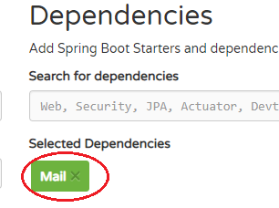

Development Steps- Create Project
A. Create Project:
Use https://start.spring.io/ to create a project with Mail
this adds this dependency to your pom.xml file
Import the Maven project to Eclipse and build it

Slide 10
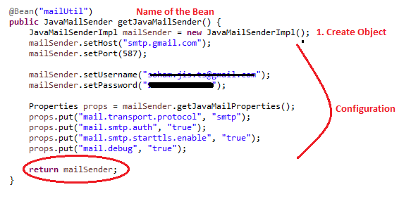
Development Steps- Coding
B. Coding:
Create a @Bean or @Component representing a JavaMailSender type

Slide 11


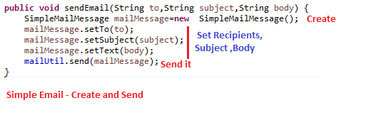
Development Steps- Coding
B. Coding Contd.:
Create a @Service to send email using the @Bean / @Component you created
Inject the @Bean / @Component
Create the method to create and send Email.

Slide 12
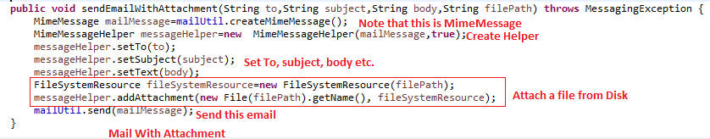
Development Steps- Coding
B. Coding Contd. :

Slide 13
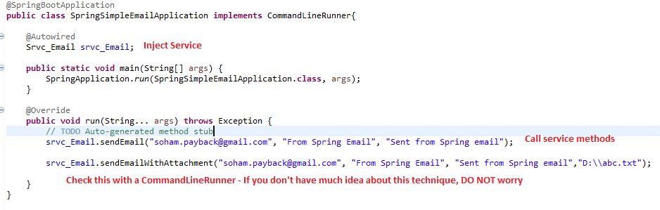
Development Steps- Coding
B. Coding Contd. :

Slide 14
Brainstorming Objectives
Assume that you have some independent modules that
Need to send Emails
Do you replicate the same code everywhere?
NO
Then ?
Why don’t we use RESTful web services ? Let’s do it
Expose a RESTful web service that can be consumed by each of the modules

Slide 15
Create RESTful services to send emails
@Autowire the service within your @RestController class
Call the method on the service object accordingly

Slide 16
Brainstorming Activity
Then -
Can anybody who knows about the service, use it, if accessible over Internet?
What’d happen if there’re many hits (E.g. 1000 requests/ second)
What happens if we wish to switch from Gmail to any other provider?
What exactly change and where?
How do we handle it -
Without re-building our code ? [Try to find an answer]
If we wish to have two / more email services ? ?
[We’ll see later on ]

Slide 17
Assignment-1
Create a RESTful web service to send email
Send a single JSON as the PAYLOAD
Chalk out a structure for the PAYLOAD
Return a meaningful Response
Test the Web service you created via
POSTMAN
Your own Spring code ( use RestTemplate)

Slide 18
Assignment-2
Create TWO services -
One to send email via a Gmail Account and the other via an OUTLOOK one
Create only one RESTful web service which
Calls the services as per need (E.g. route to the service desired)
Must use – HTTP / POST
Finally, make post a single JSON to route to the proper service

Slide 19


Assignment-2.1 [NB. Content based routing]
Create TWO RESTful services -
One to send email via a Gmail Account and the other via an OUTLOOK one
Create another RESTful web service in another application. CLIENT must call this only [Assume that the above two are private services and cannot be accessed by the CLIENT]
Routes to desired web services
Must use – HTTP / POST
Finally, make post a single JSON to route to the proper service
Public API

Slide 20

Questions ?

